Slide 1


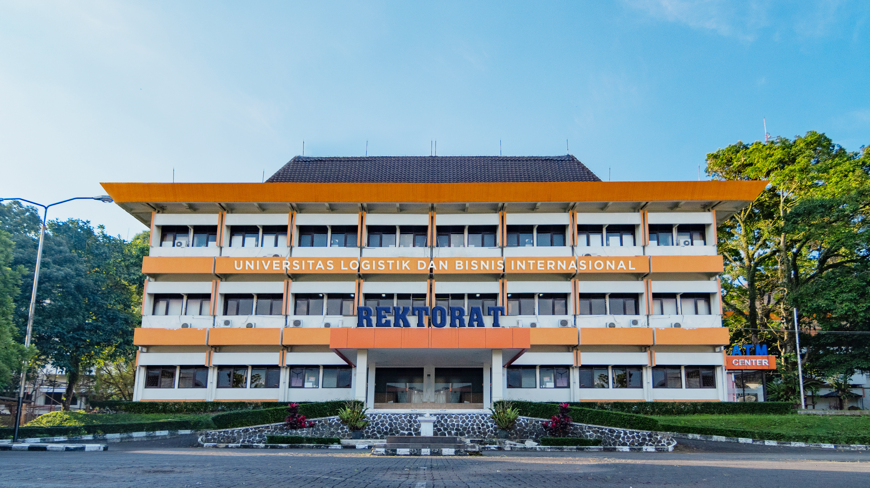


#CreatingBestTalentForBrightFuture
www.ulbi.ac.id
www.ulbi.ac.id

Slide 2
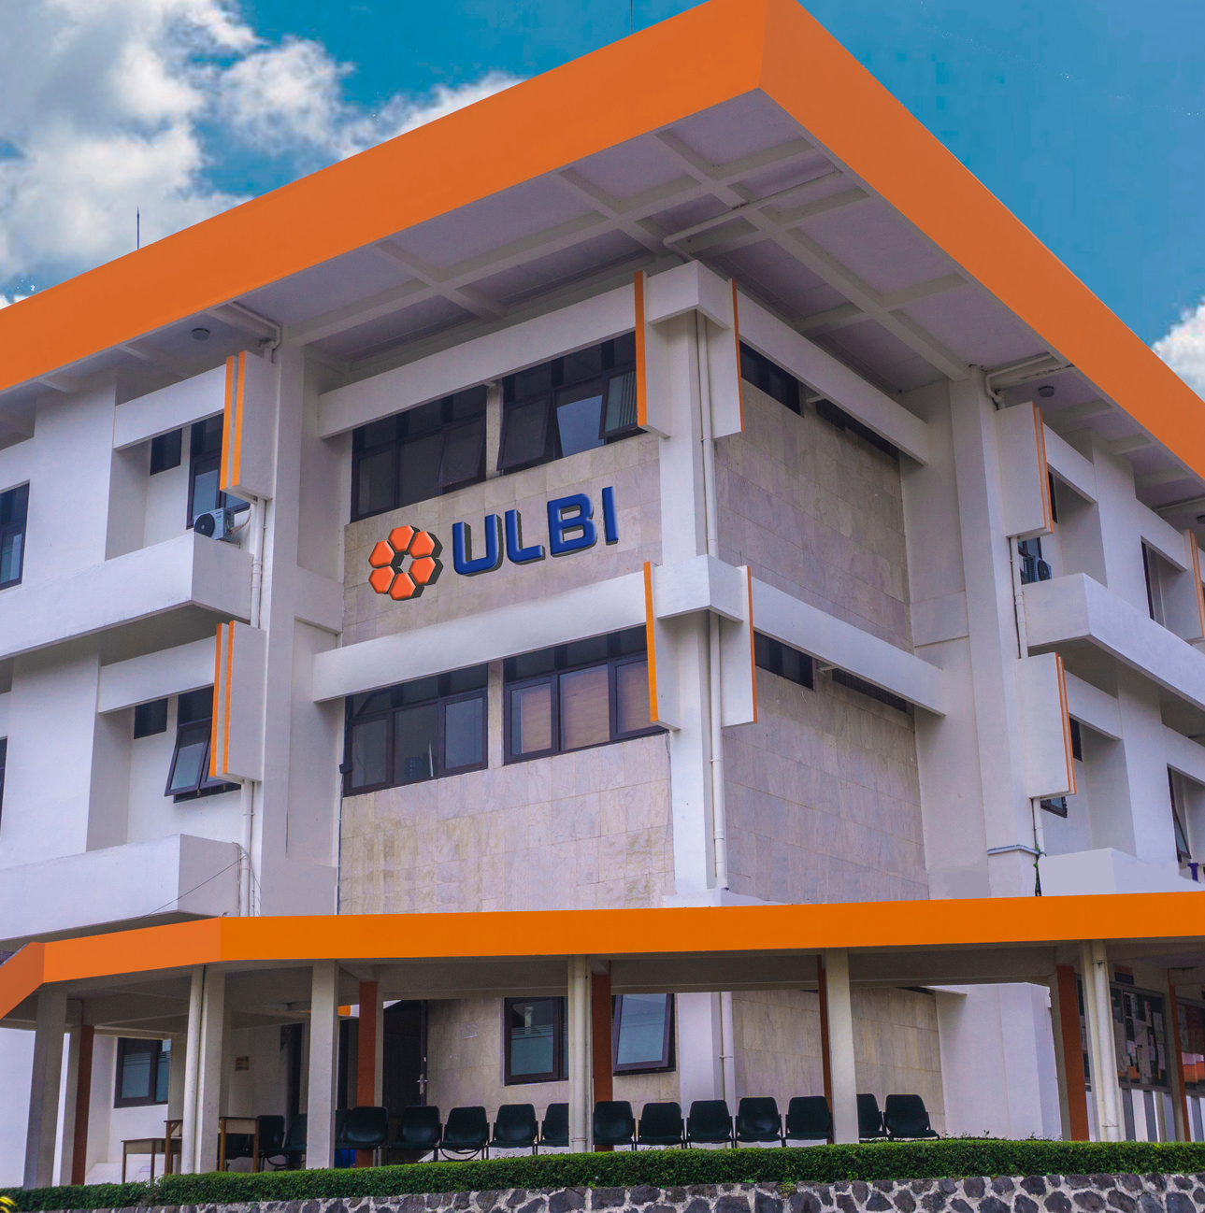
#CreatingBestTalentForBrightFuture
www.ulbi.ac.id
www.ulbi.ac.id

Slide 3


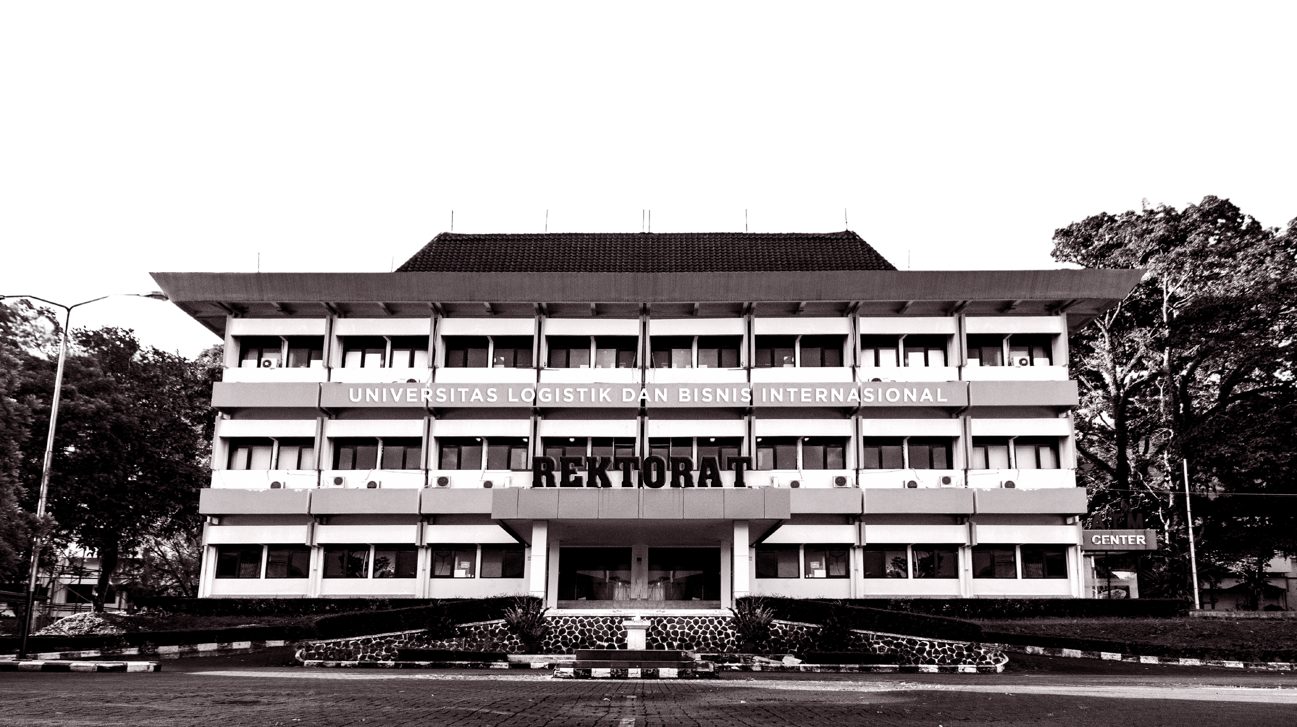


#CreatingBestTalentForBrightFuture
www.ulbi.ac.id

Slide 4
#CreatingBestTalentForBrightFuture
www.ulbi.ac.id

Slide 5

#CreatingBestTalentForBrightFuture
www.ulbi.ac.id

Slide 6
#CreatingBestTalentForBrightFuture
www.ulbi.ac.id

Slide 9




#CreatingBestTalentForBrightFuture
@ulbi.official
@admission.ulbi
@ulbi.official
@ulbi.admission
ULBI OFFICIAL
ULBI
www.ulbi.ac.id
www.admission.ulbi.ac.id

Slide 10
#CreatingBestTalentForBrightFuture
@ulbi.official
@admission.ulbi
@ulbi.official
@ulbi.admission
ULBI OFFICIAL
ULBI
www.ulbi.ac.id
www.admission.ulbi.ac.id

